Slide 1
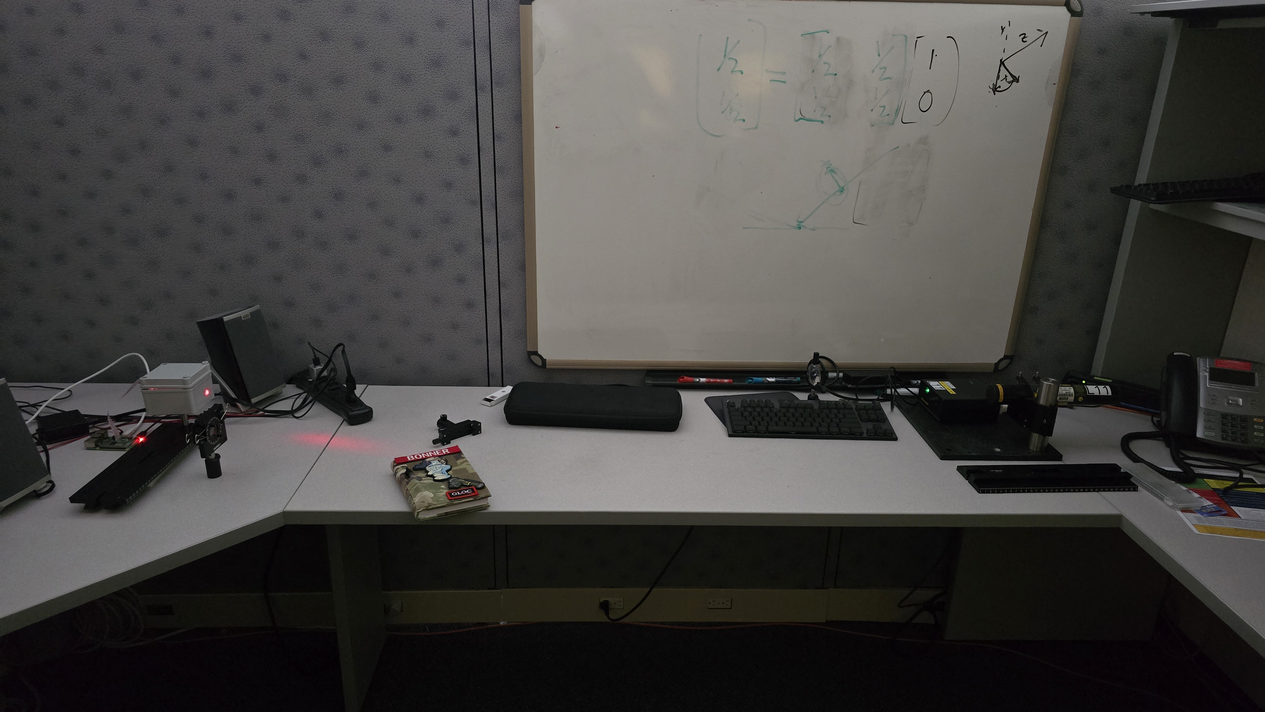
2d Lt Aaron Bonner
Polarization

Slide 2
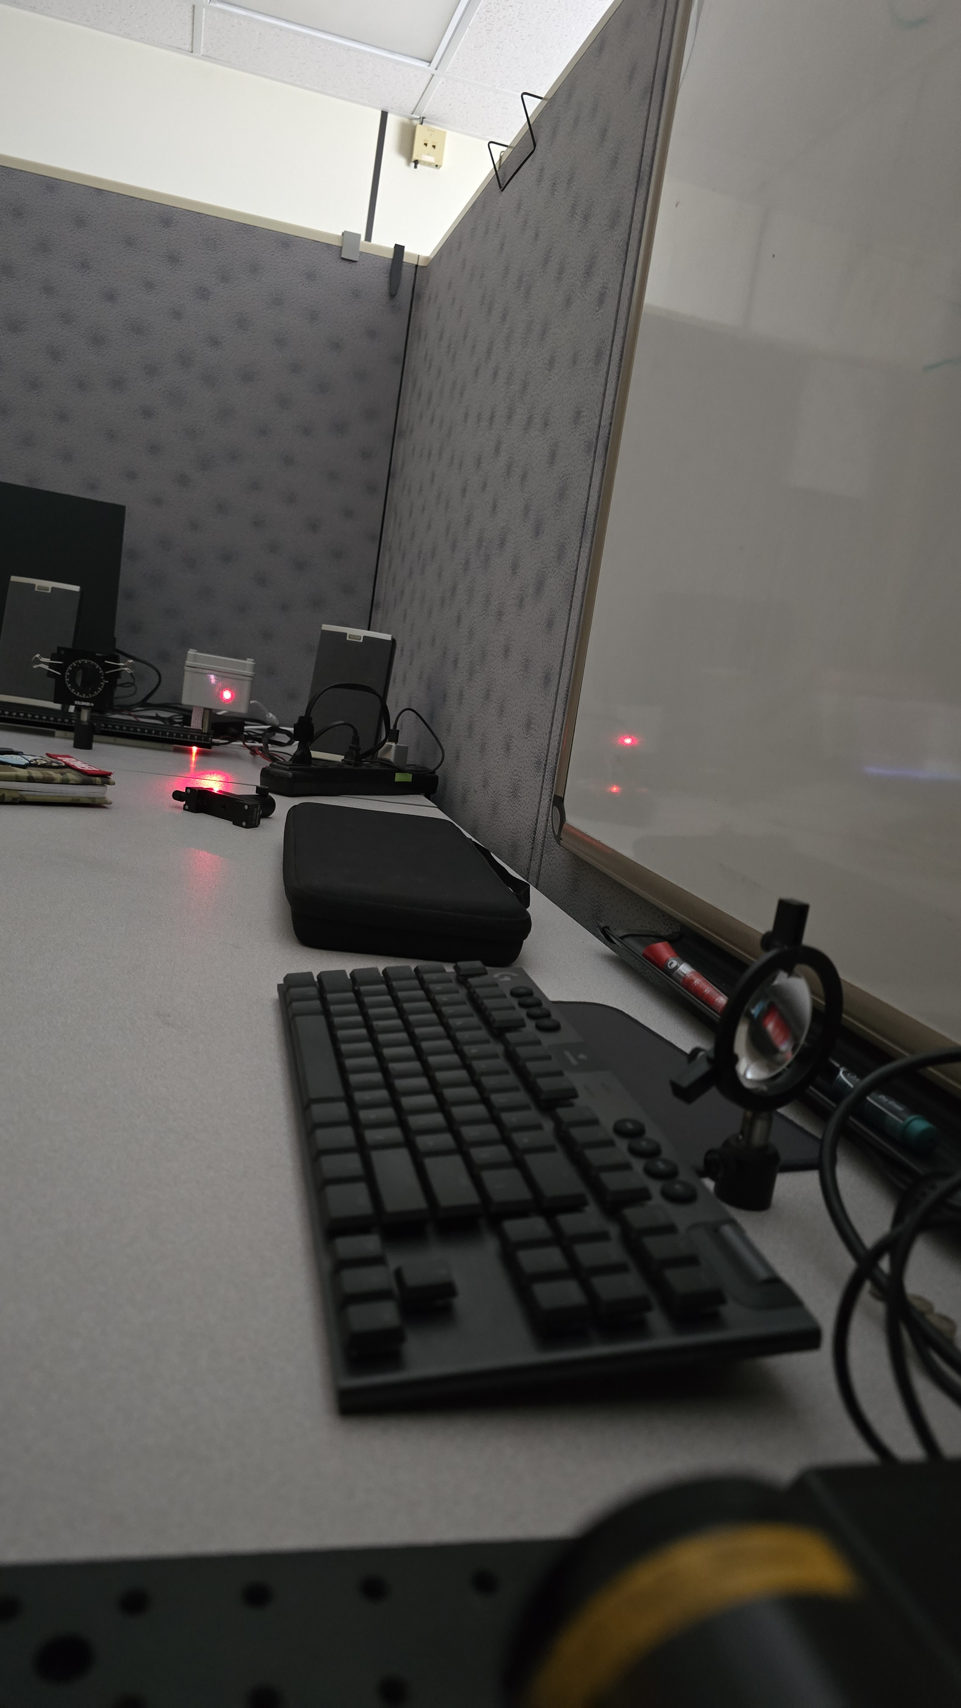
Lab Setup
Hardware Setup
Laser
Filter/Aperture
Sensor
Laser polarization angle determination
Exposure time experimentation

Slide 3
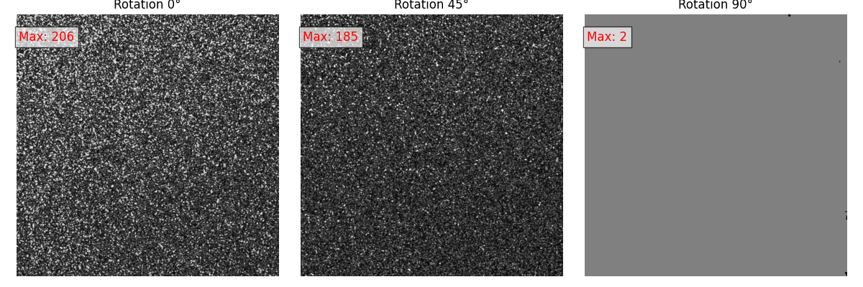
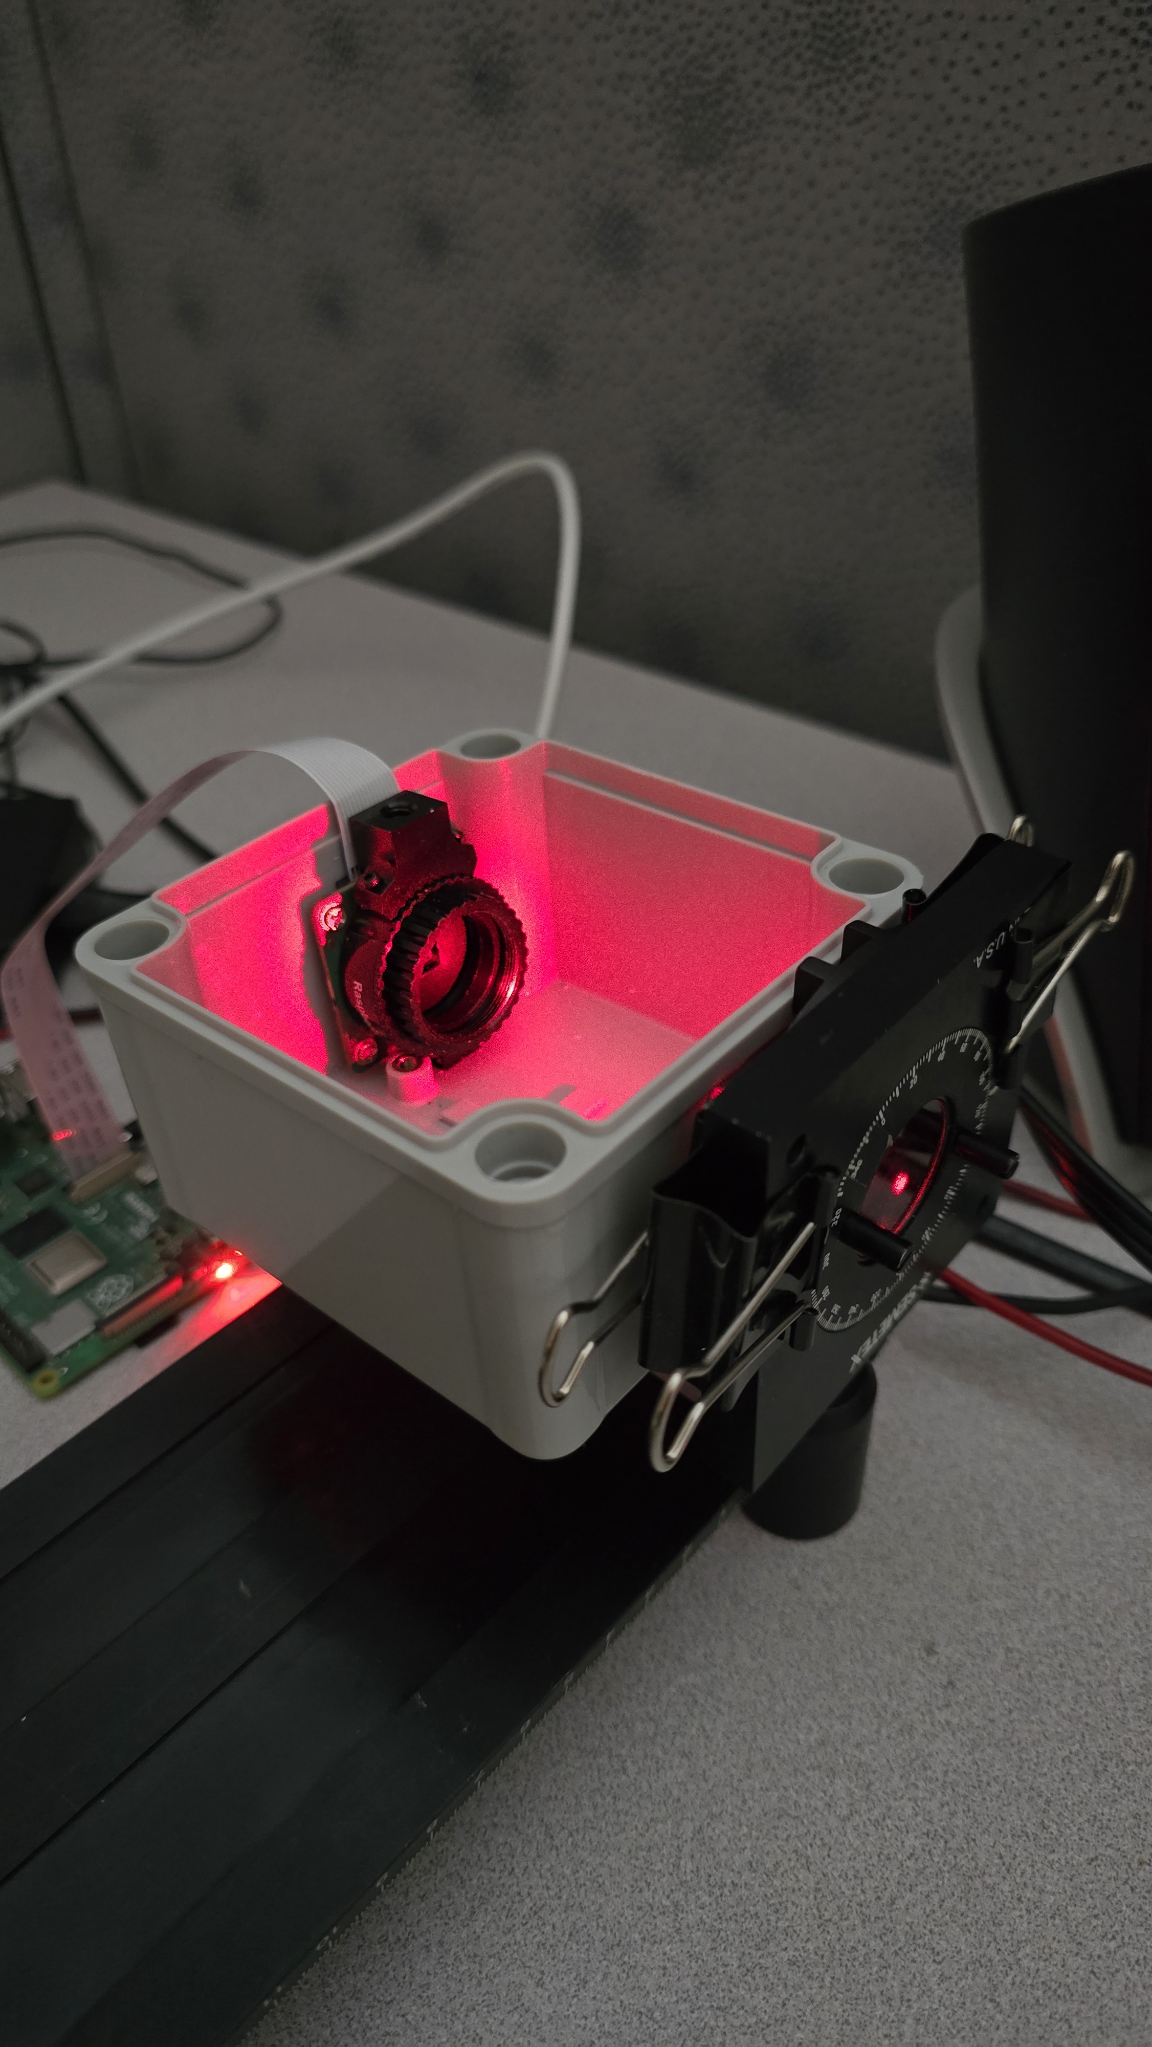
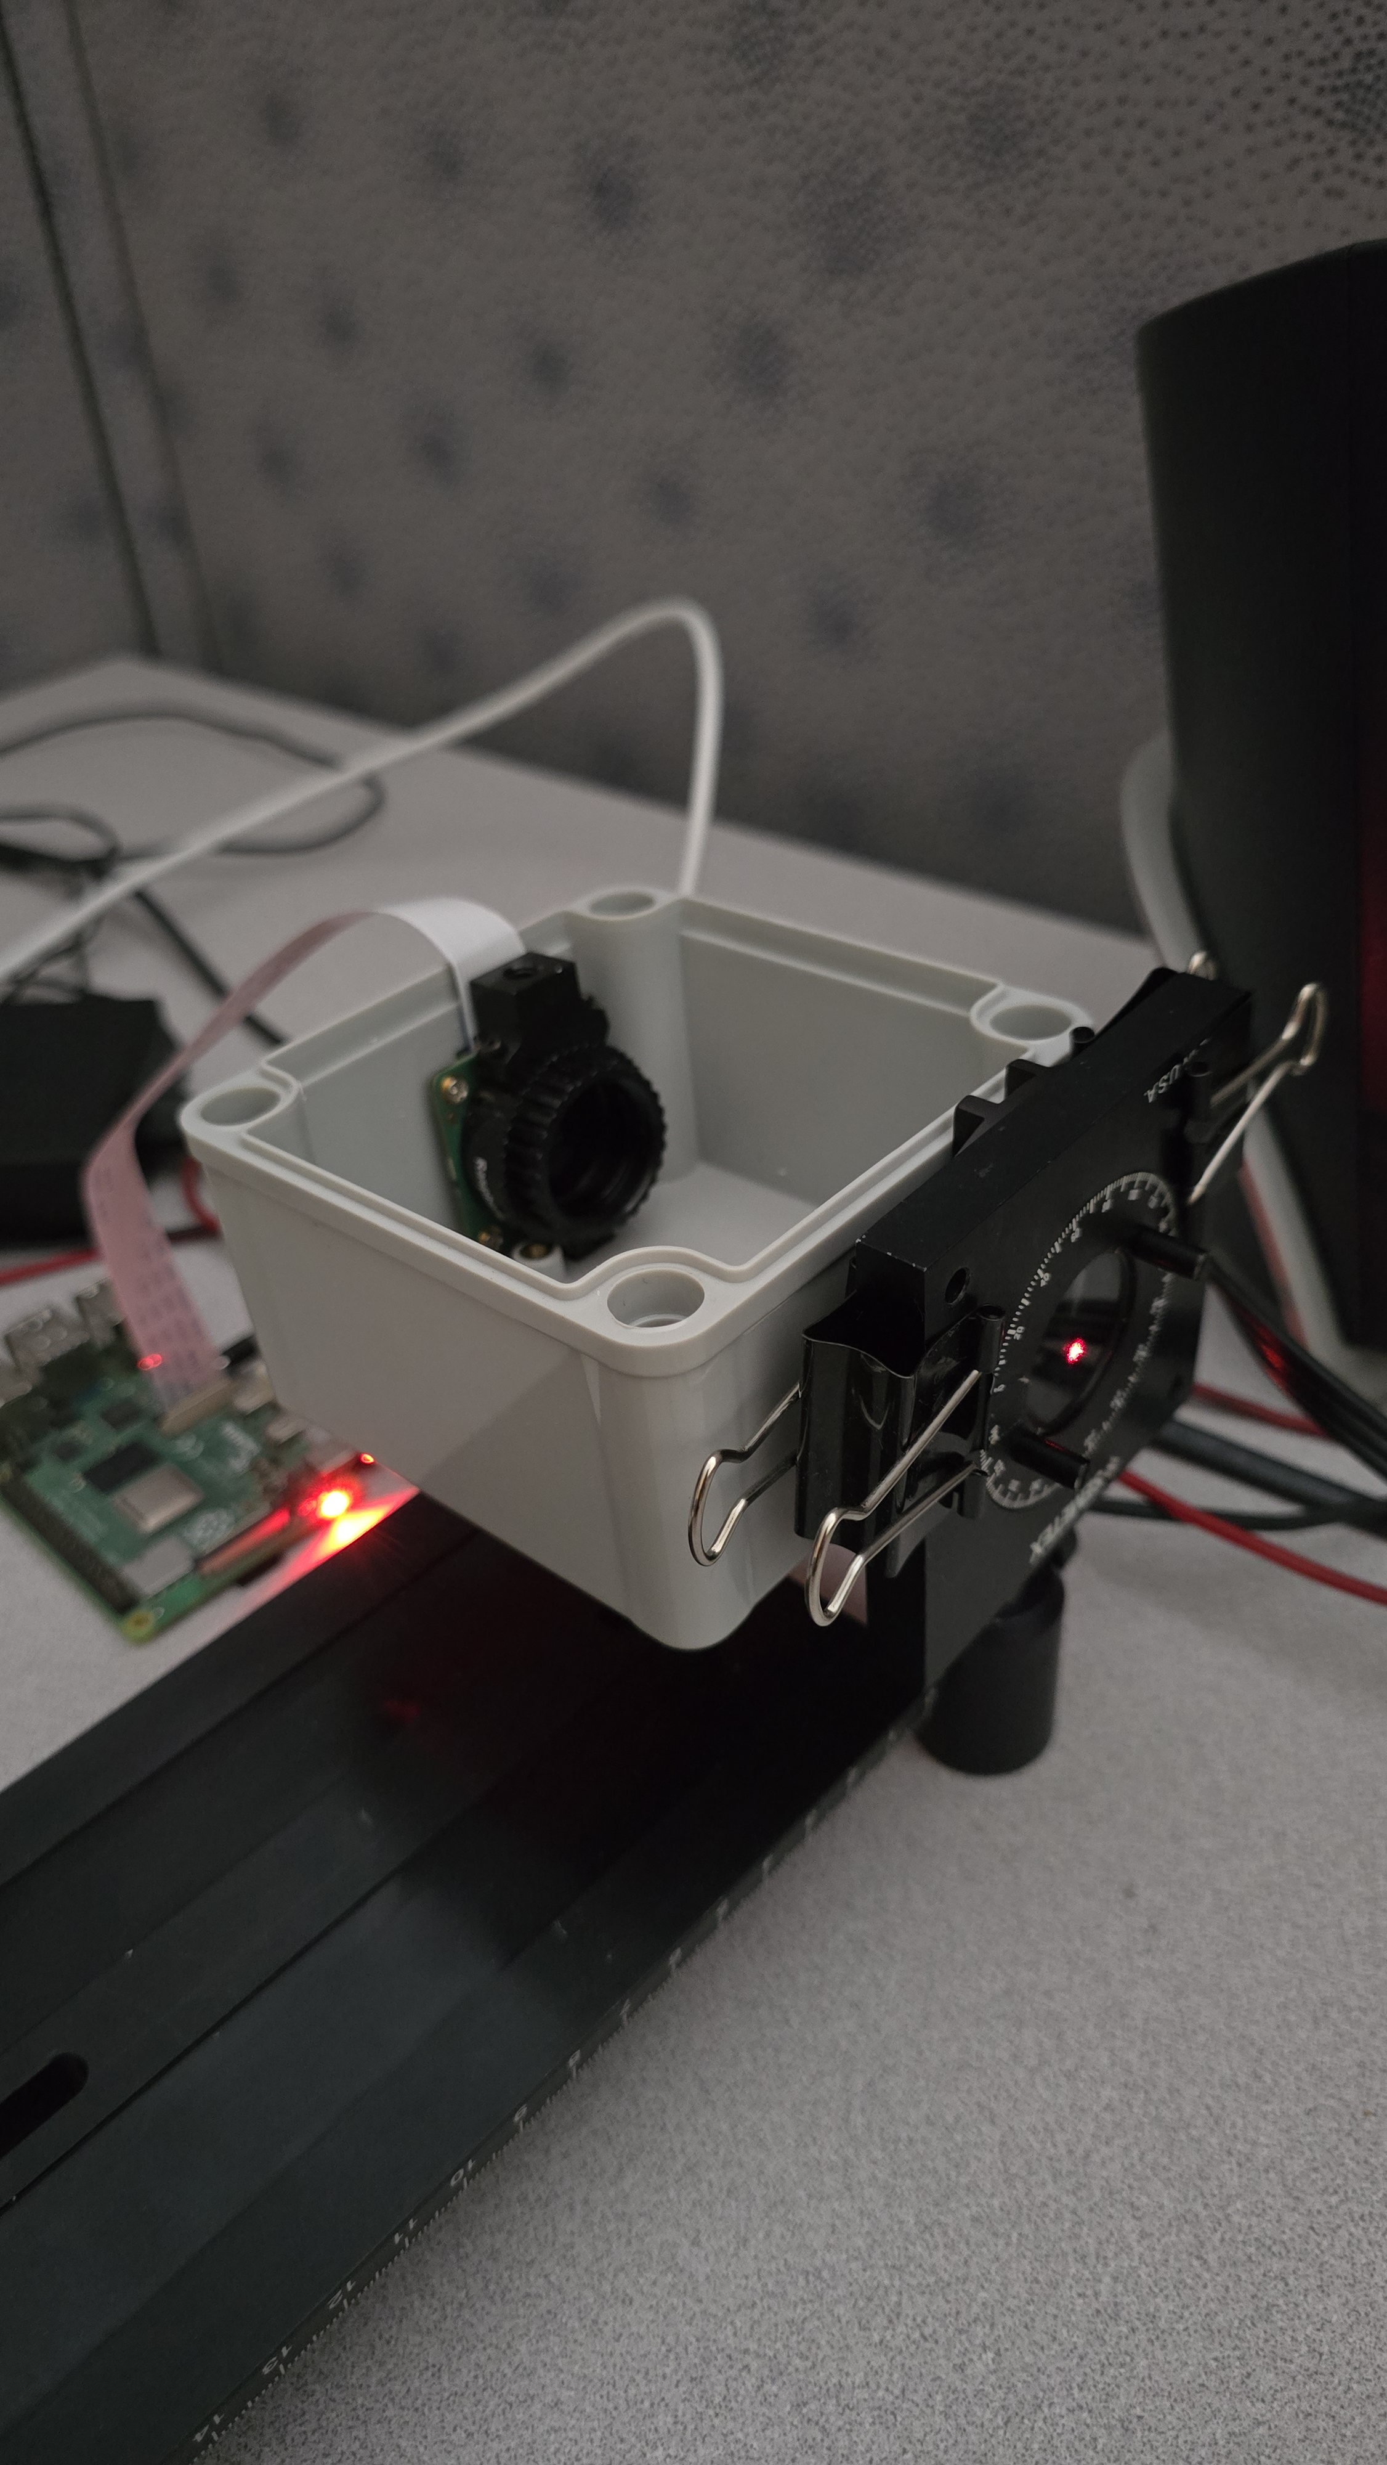
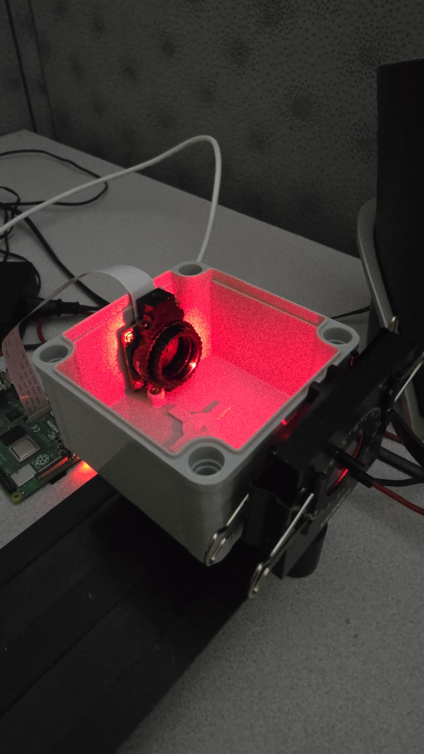
Data Capture

Slide 4
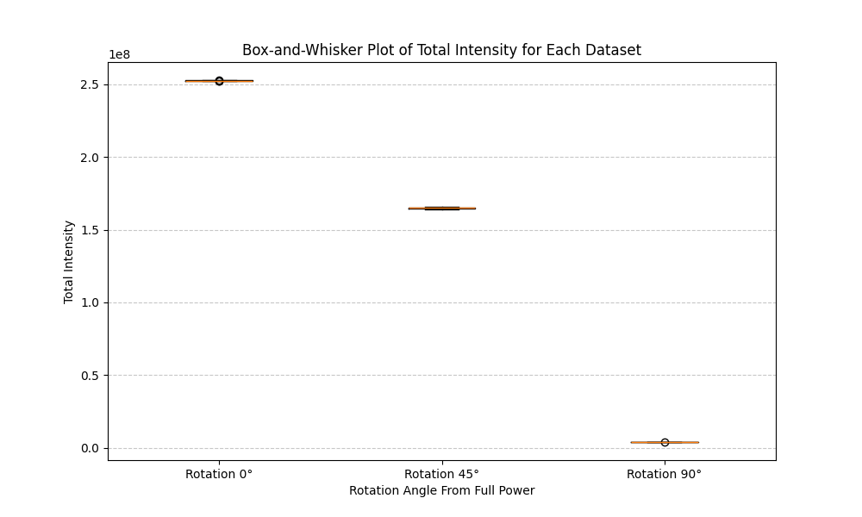
Data Generation and Preparation

Slide 5

Questions
This Photo by Unknown Author is licensed under CC BY-NC-ND

